Slide 1
Feature Selection and Importance
Dr. Umberto Michelucci
umberto.michelucci@toelt.ai

Slide 2
Feature Importance
Feature Importance
Feature importance refers to techniques used to assign a score to input features based on how useful they are at predicting a target variable.
These scores provide insight into the relative importance or contribution of each feature to the model's prediction. The higher the score, the more significant the feature is deemed to be in the context of the model's performance.

Slide 3
Feature Selection
Feature Selection
Feature selection is the process of selecting a subset of relevant features for use in model construction. The goal is to reduce the number of input variables to those that are believed to be most useful to predict the output variable. This not only simplifies the model but can also improve its performance by reducing overfitting and improving generalizability.

Slide 4
Methods for Feature Selection/Importance
Filter Methods: These methods use statistical techniques to select features based on their relationship with the target variable, independently of any modeling algorithm (e.g., correlation, chi-square test).
Wrapper Methods: These methods evaluate multiple subsets of features, selecting those that produce the best-performing model according to a specified performance metric (e.g., recursive feature elimination).
Embedded Methods: These methods perform feature selection as part of the model training process (e.g., LASSO regression, which includes a penalty term that can reduce coefficients of less important features to zero).

Slide 5
Wrapper Methods

Slide 6
Forward Feature Selection

Slide 7
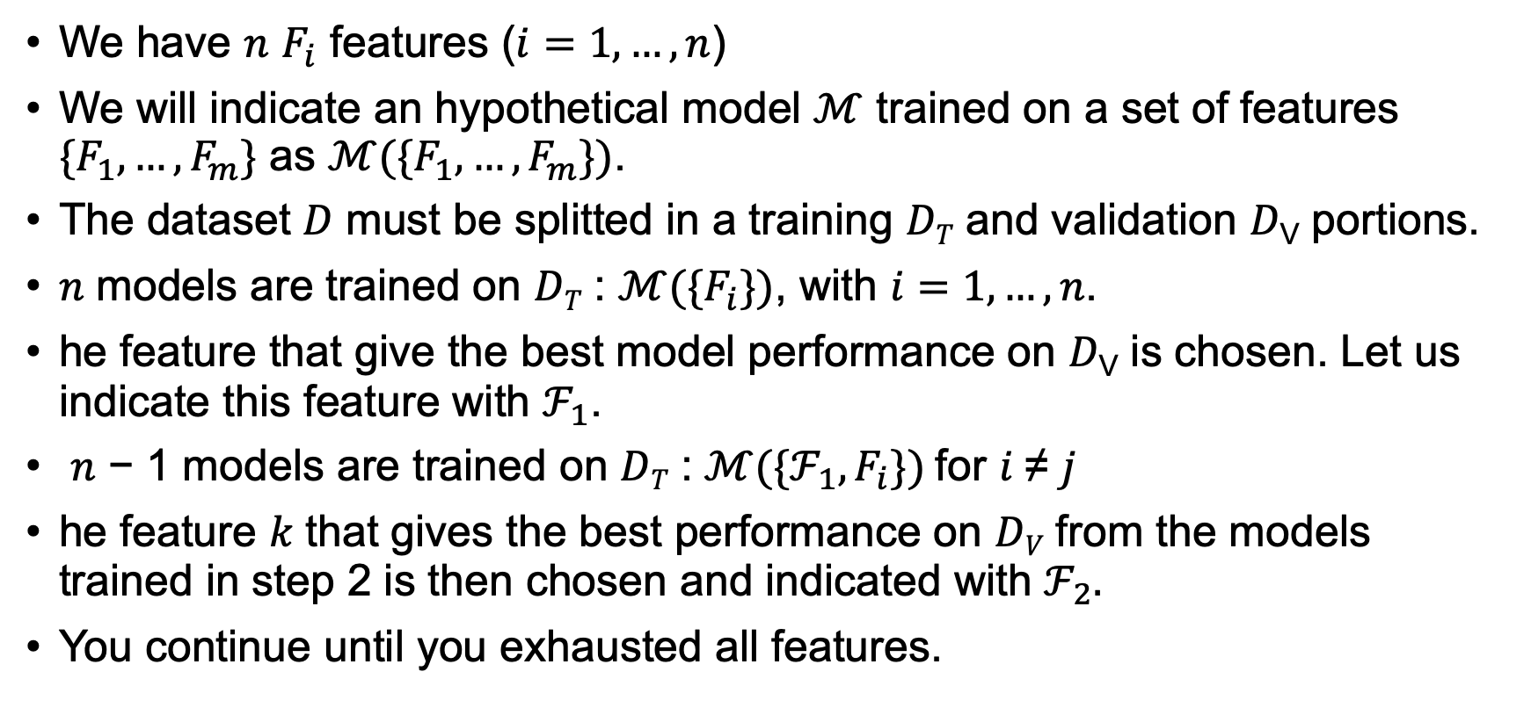
Forward Feature Selection (described for a hold-out approach)
We have $n$ $F_{i}$ features ($i=1,…,n$)
We will indicate an hypothetical model $ℳ$ trained on a set of features $\{F_{1},…, F_{m}\}$ as $ℳ(\{F_{1},…, F_{m}\})$.
The dataset 𝐷 must be splitted in a training 𝐷_{𝑇} and validation 𝐷_{V} portions.
𝑛 models are trained on 𝐷_{𝑇} : $ℳ(\{F_{i}\})$, with $i=1,…,n$.
he feature that give the best model performance on 𝐷_{V} is chosen. Let us indicate this feature with $ℱ_{1}$.
𝑛 − 1 models are trained on 𝐷_{𝑇} : $ℳ(\{{ℱ_{1}, F}_{i}\})$for 𝑖 ≠ 𝑗
he feature 𝑘 that gives the best performance on 𝐷_{𝑉} from the models trained in step 2 is then chosen and indicated with $ℱ_{2}.$
You continue until you exhausted all features.

Slide 8
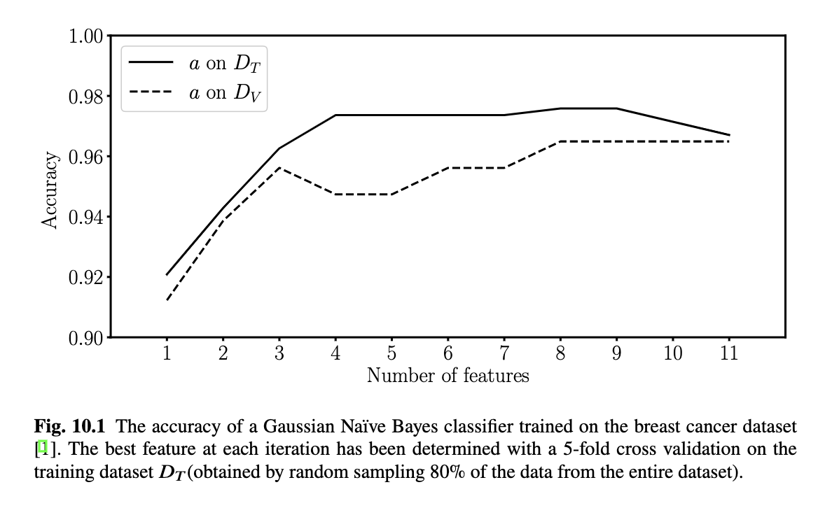
Example with the Breast Cancer Dataset

Slide 9
Backward Feature Selection

Slide 10
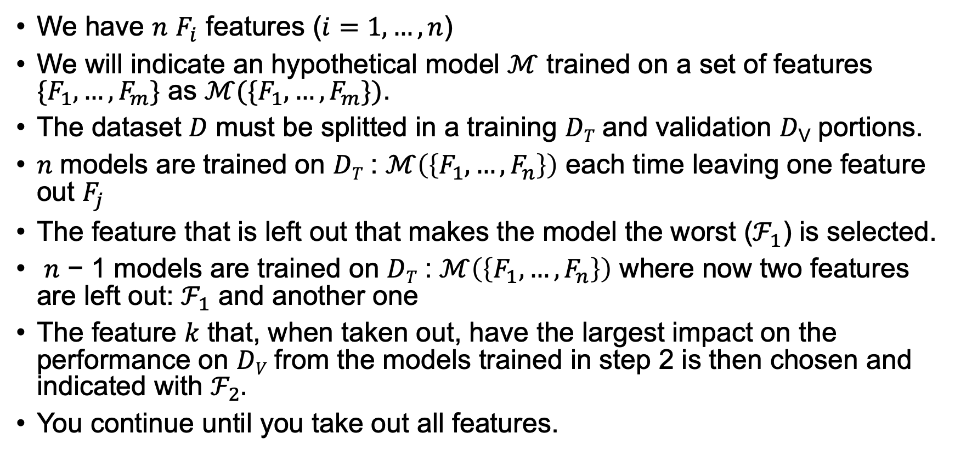
Forward Feature Selection (described for a hold-out approach)
We have $n$ $F_{i}$ features ($i=1,…,n$)
We will indicate an hypothetical model $ℳ$ trained on a set of features $\{F_{1},…, F_{m}\}$ as $ℳ(\{F_{1},…, F_{m}\})$.
The dataset 𝐷 must be splitted in a training 𝐷_{𝑇} and validation 𝐷_{V} portions.
𝑛 models are trained on 𝐷_{𝑇} : $ℳ\left(\left\{F_{1},…,F_{n}\right\}\right)$ each time leaving one feature out $F_{j}$
The feature that is left out that makes the model the worst ($ℱ_{1}$) is selected.
𝑛 − 1 models are trained on 𝐷_{𝑇} : $ℳ\left(\left\{F_{1},…,F_{n}\right\}\right)$ where now two features are left out: $ℱ_{1}$ and another one
The feature 𝑘 that, when taken out, have the largest impact on the performance on 𝐷_{𝑉} from the models trained in step 2 is then chosen and indicated with $ℱ_{2}.$
You continue until you take out all features.

Slide 11
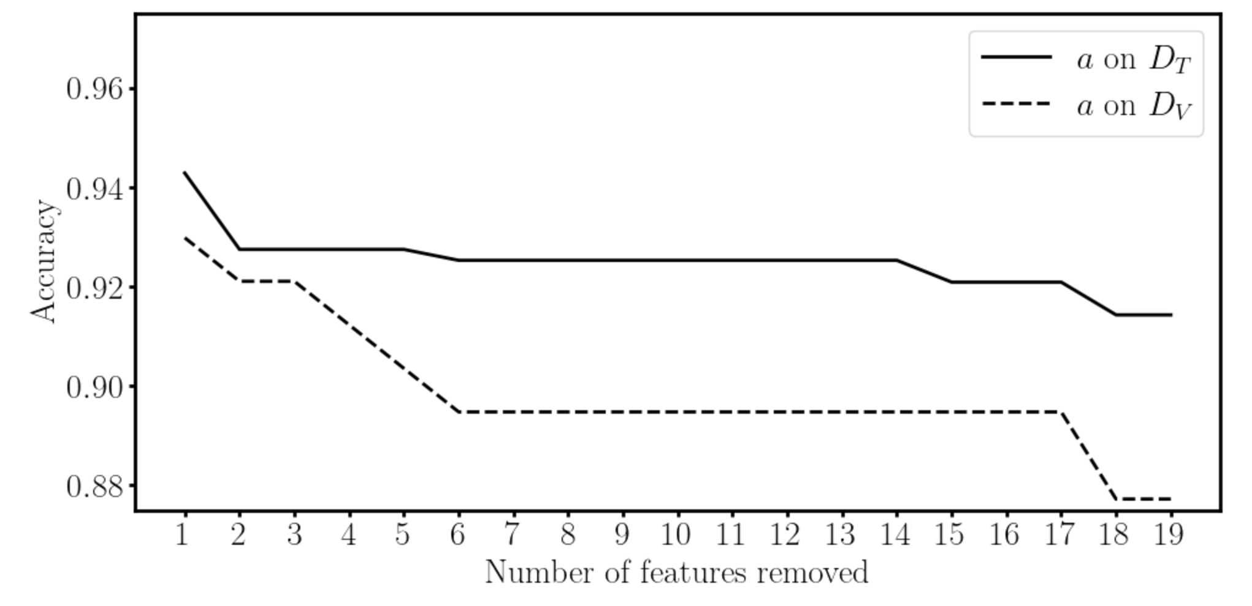
Example with the Breast Cancer Dataset

